Slide 1



ENERGY TRACKING FRAMEWORK
by Bit Byte

Slide 2


SAVING ENERGY TODAY WILL MAKE
TOMORROW BRIGHT

Slide 3





Data Project
Rely on questionnaire method using Google Form
Our target audience only comprises individuals from the KICT department.
The questionnaire/Form was circulated among KICT-related groups via Whatsapp and Telegram.
Within the questionnaire, we sought to explore respondents' perspectives on various aspects related to our project idea
By inviting their insights and opinions, we aim to enrich our understanding of potential challenges, opportunities, and innovative solutions within the KICT department.

Slide 4
Methadology
Google Form
Google form is useful for us as the analyst to get some importatnt details regarding our project to create a system for Feasable Energy Tracking in KICT.
Observation
Observation also works as an overview for us to get ideas about this project, also, it helps us how to improve the system in the near future.

Slide 5
Target Users
KICT Students & Staff
The purpose of Google Form is to gain usefull infromnation and analytics about user’s experience with existing lighting and air condition system in KICT, IIUM

Slide 6
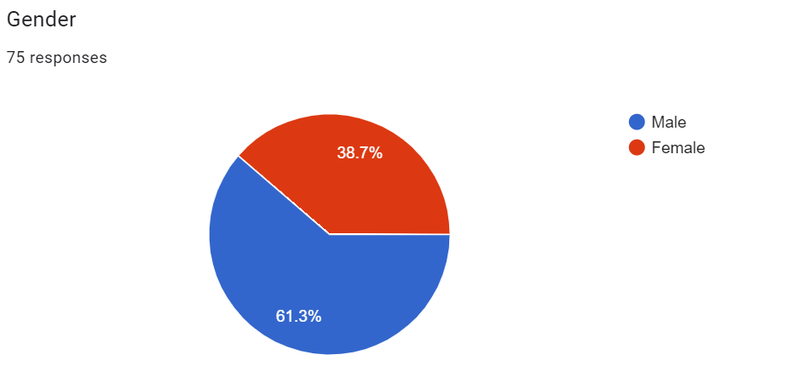
List of Questions & Analytics

Slide 7
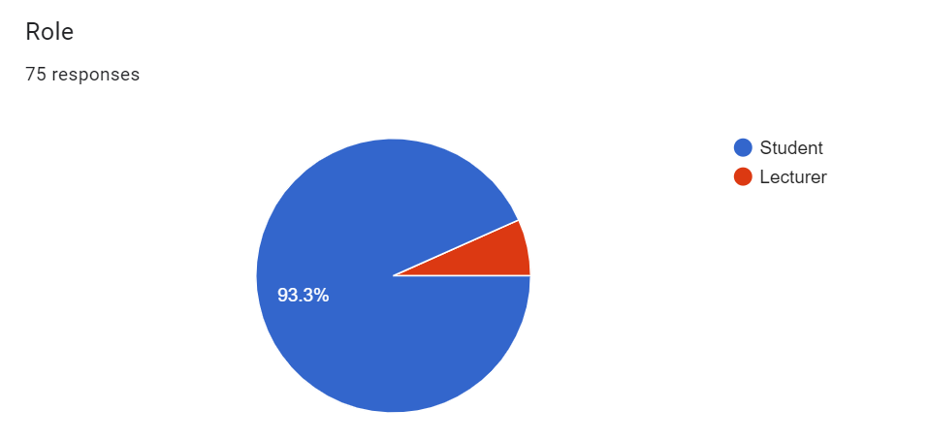
List of Questions & Analytics

Slide 8
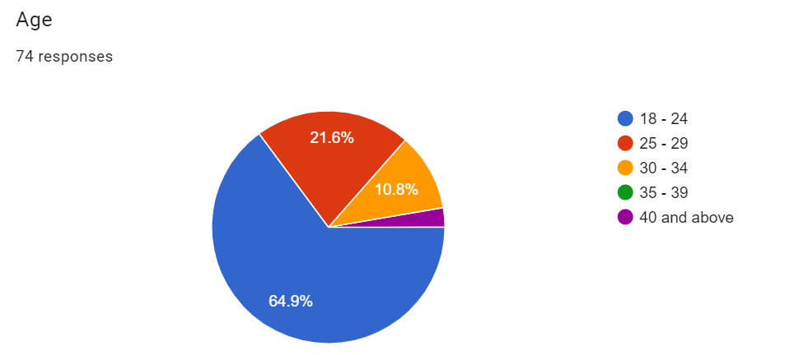
List of Questions & Analytics

Slide 9
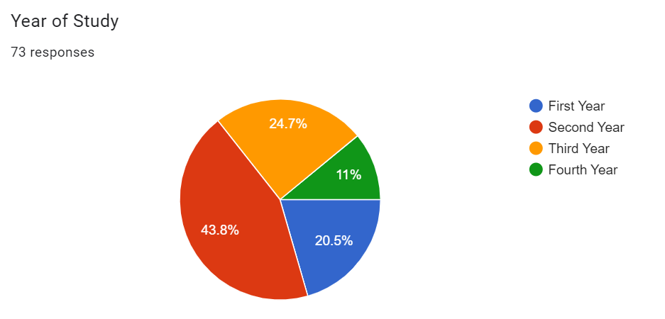
List of Questions & Analytics

Slide 10
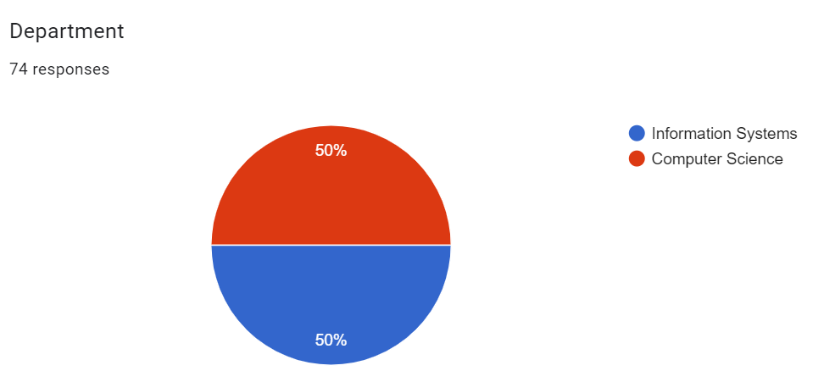
List of Questions & Analytics

Slide 11
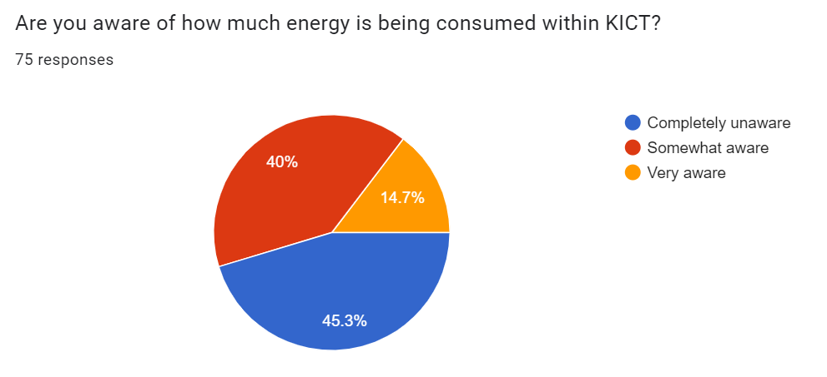
List of Questions & Analytics

Slide 12
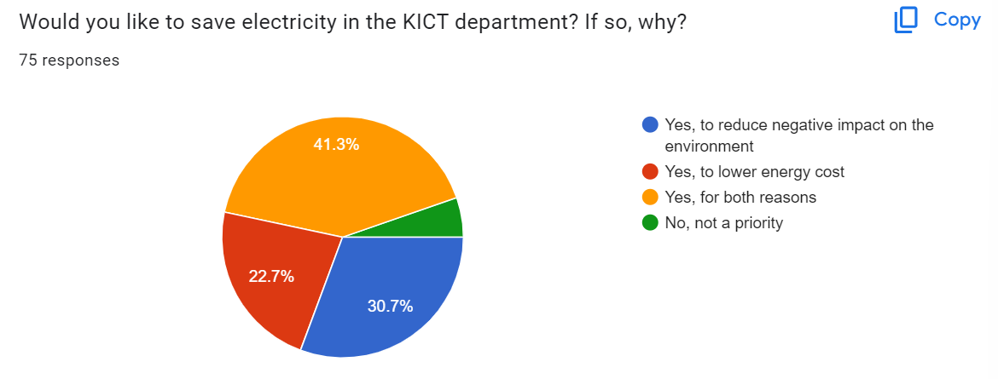
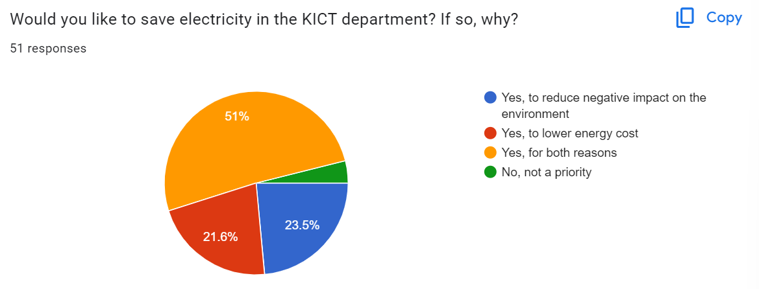
List of Questions & Analytics

Slide 13
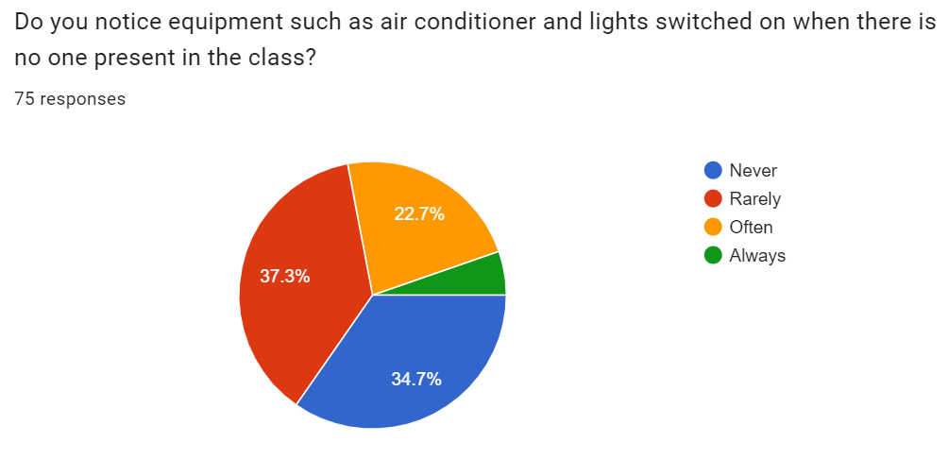
List of Questions & Analytics

Slide 14
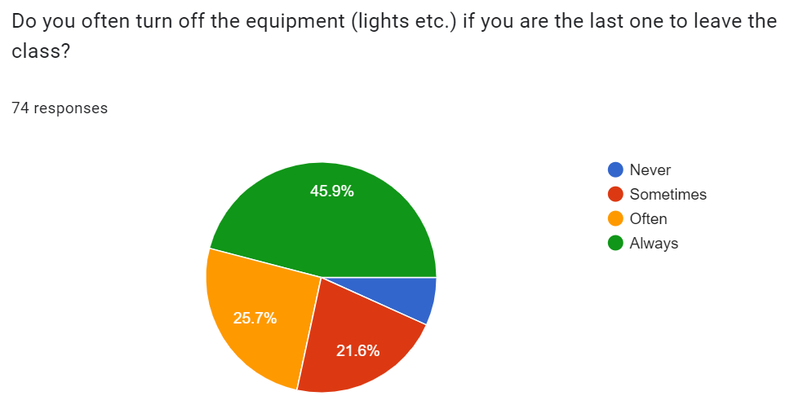
List of Questions & Analytics

Slide 15
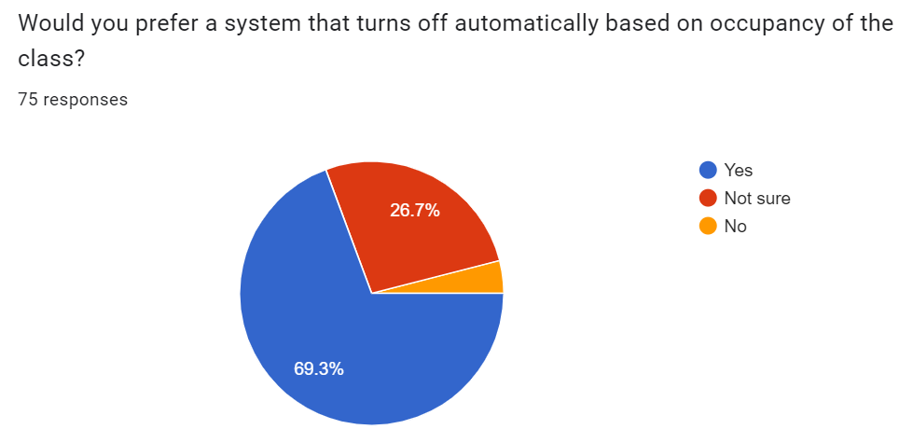
List of Questions & Analytics

Slide 16
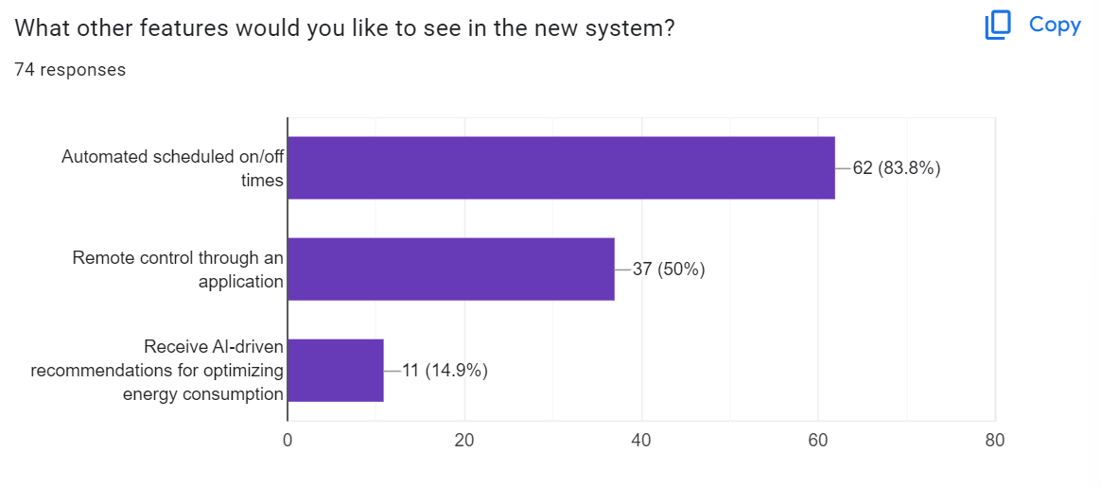
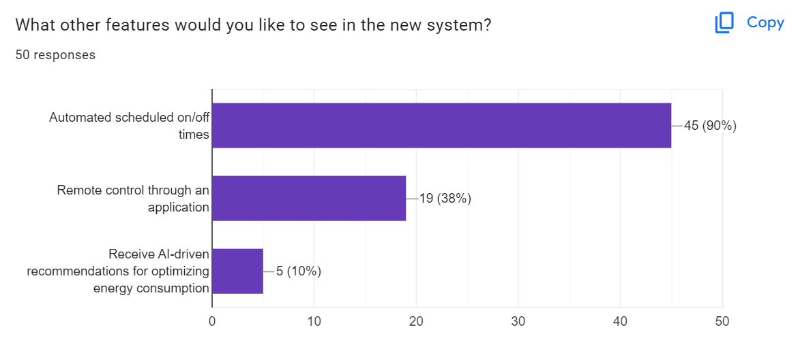
List of Questions & Analytics

Slide 17
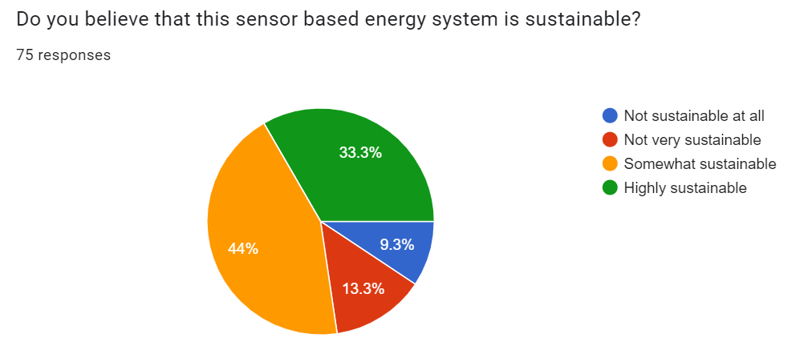
List of Questions & Analytics

Slide 18
Data Collection Results
Our survey consisted of a total of 75 respondents, including 70 students (93.3%) and 5 lecturers (6.7%). Majority of respondents (65%) were between the ages of 18-24.
Regarding the awareness of energy consumption in KICT - only 14.7% are very aware, 40% somewhat aware, and 45.3% are completely unaware of how much energy is consumed within KICT.
Majority of respondent prefer to save electricity within the KICT department to either reduce negative impact on environment (30.7%) and to also save costs (22.7%). Another 41.3% voted for both benefits and the other 5.3% do not put saving electricity as a priority.

Slide 19
Data Collection Results
Out of the 75 respondents, 54 (72%) of them rarely or never notice equipment such as lights or air conditioner being left on unattended in a venue.
Fortunately, most of the respondents (71.6%) claim to often or always switch of all equipment when being the last one to leave the venue.
69.3% of respondent would prefer a system that turns off automatically based on occupancy of the class and another 26.7% are not sure. If a system were to be implemented, 77.3% think it would be highly or somewhat sustainable.

Slide 20
Conclusion
In summary, the data collected paints a comprehensive picture of the current state of energy consumption at KICT. It highlights the awareness levels, attitudes, and behaviors towards energy usage among students and staff.
The report suggests a strong foundation for developing an effective Energy Tracking Framework, tailored to meet the specific needs and preferences of the KICT community. The study emphasizes the potential of technology-driven solutions in promoting sustainable energy practices in an educational environment.

Slide 21
Thank You
Any Questions?
bit byte

